Slide 1
We have a new Council Calendar at Scoutsiowa.org!

Slide 2
And it’s not just a basic calendar, there are a lot of new features! First, the calendar can be viewed in a few different ways. - Month view - List view - Search events
Notes:
In “List View” you are able to see a more concise chronological list of events and meetings. You are able to scroll down on this screen and see all the known events & meetings for the next year.

Slide 3
Search Events View Events: activities or events that require registration or an RSVP in advance. Meetings: those that do not require advanced registration, such as Roundtable.
Notes:
Again, events are listed in chronological order.

Slide 4
Are you looking for a specific event? Want to share all the training options for the year with your unit volunteers? Every event & meeting is categorized, so you can search for specific things.
Notes:
Other examples of a specific category you might be looking for is the OA, Cub Scouts, etc. You can also click more than one category at a time, maybe Boy Scouts & Advancement. You can also search by district.

Slide 5
By hovering over any calendar entry, you can find out the date, time, & location of the event.
Notes:
Again, that’s by hovering. You don’t even have to click anything.

Slide 6
By clicking on a meeting, a box will pop up with a bit more information.
Notes:
Again this is a meeting, something that does not require registration. “Catch up on everything happening in the District. Discuss options or issues and build fellowship. Open to all volunteers.” Let’s look at an event now.

Slide 7
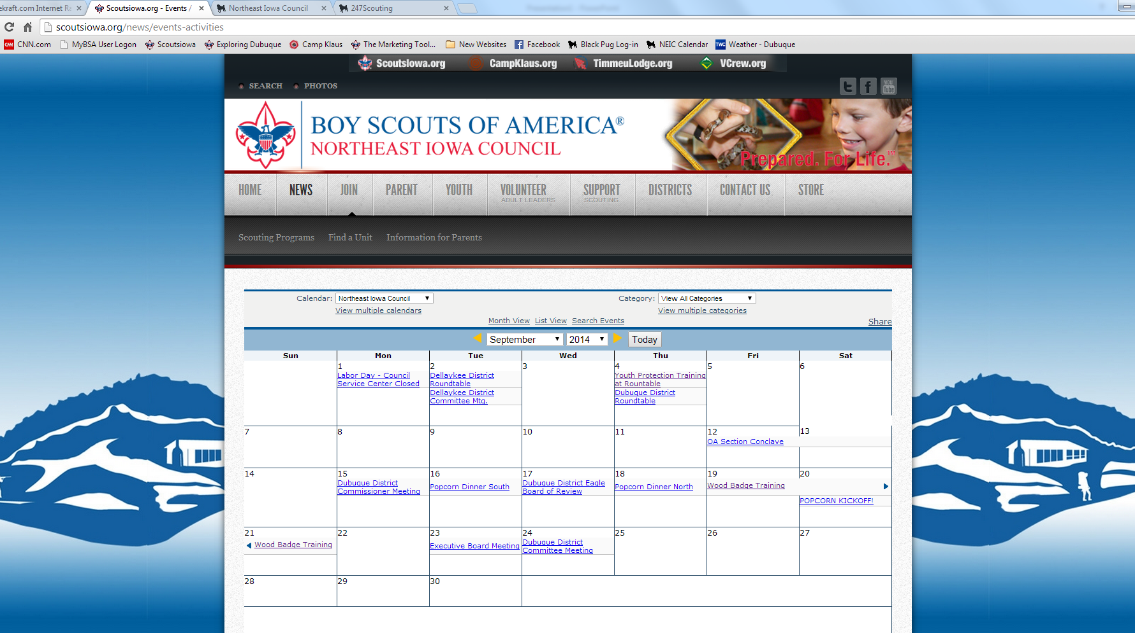
Notes:
Next Roundtable we have Youth Protection Training available during breakout sessions. Even though this is a free event, it is still an event that we would like you to RSVP for as a courtesy to the planning of our Training Chair, David McElroy (Mac-L-Roy). So we are going to click on that now. When you click on an event open for registration, a new page will open in a new tab with all the info for that event.”

Slide 8
Every event that is open for registration will have a page like this. Looks nice, doesn’t it?
Notes:
Let’s go through some of the things on this page.
Registration Box: Location, date time. Registration type. (Is this event open to adults? Youth? Both? Are family members allowed to participate?) This will list the options here. Next we have the price quantity, and the register now button. We’ll come back to this in just a bit.
Event Details: Summary of the event, any special notes, requirements, etc. Again this is in a new tab, so the full calendar is still available in the tabs at the top of you browser. And second, it allows this event to have it’s own URL. So you can copy and paste this direct link to a volunteer who needs to sign up, or if a new parent is requesting something. Each event will have it’s own URL.
Picture Box: All will have a picture here, whether it be the OA Lodge Logo, or the Camp Klaus logo.
When & Where: Features the exact Google location. By clicking on this it would open Google Maps in a new tab allowing you to get directions from your location.
Attachments: There aren’t any for this event, but any flyers for the event, or extra forms we need would be listed here in another labeled box below “When & Where.”
Contact Us: Each event will always have the Council Office contact information listed right here. If there is a specific contact for this event, it will also be listed. Which I think is really nice. I know sometimes people might not be sure which office staff member overseas a specific event, or maybe a specific volunteer would want to be listed here.
Before I take you through how to register for that event, I need to point out one very important thing...

Slide 9
If I do not have all the information I need to open registration for an event, this is what will appear. Save the Date = Someone needs to talk to Melissa when these details are finalized! We are NOT producing a printed calendar this year!
Notes:
I love that is allows us to put a Save the Date on here, because it is such an easy indicator that we do not have all the information we need. And since the Council is not producing a printed calendar this year, if the website doesn’t know the details, our Scouts & their families don’t know all the information they need.
I have been joining you at Roundtable for a while now, encouraging everyone to inform me of their event details. It is now a requirement. The committees or volunteers in charge of District or Council events or activities needs to contact me when the details are finalized. Tell me the date as soon as it is known so I can get it on here in the save the date mode.
In everyone’s Roundtable folders there was a handout summing all this information up for you. It has my contact info on both sides. Call me, text me, e-mail me, CC me on the final e-mail to Peter, add me to your committee e-mail list, I do not care. But once your committee decides the details of your event, I need to know them! I promise I’m very friendly.
If anyone has questions or would like to discuss why we are not printing a calendar this year, I’d be happy to do that in the break out sessions or at the end, but I just don’t want to take up the group’s time with that right now.
Now let’s go back and register for Youth Protection.

Slide 10
Let’s register for this event. It’s easy!
Notes:
For the sake of this demonstration, I went ahead and registered myself to take your through the process.
We are going to change the Quantity of Registrants to 1 and click register now.

Slide 11
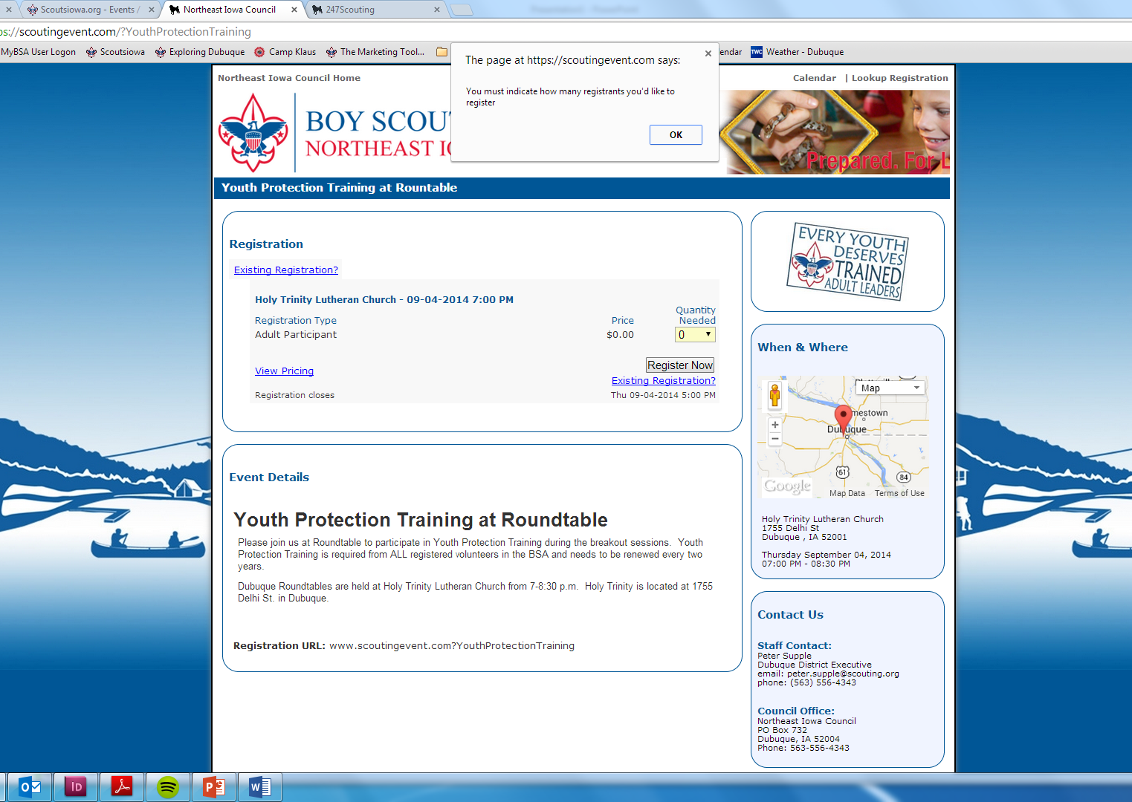
It is programmed to help you along, and catch any mistakes.
Notes:
Another awesome thing about this software is that it is set up to catch your mistakes. For example, if we forgot to check how many we were registering, and just clicked register now, it let’s us know.
It also does this on my end for set up. I can never forget an aspect of an event, for example the time or location. It takes me through each step and I have to physically select “No location” or “location to be determined.” for it to let me continue. So it’s very helpful to everyone involved.

Slide 12
Every registration you begin will ask for a main contact person. You can also finish an existing registration, or add another Scout to your registration if attending as a group.
Notes:
Main Contact person would be the parent for a youth, or it might be the den leader or unit leader if they are signing up a group of kids.
The Main Contact will be the person who receives the e-mail notifications regarding the event.
There are these nice little helpers throughout the process to explain each step.
Enter the first and last name and e-mail of your main contact and click “Start Registration.”

Slide 13
- The Council will always default to the NEIC. - Pick your unit type. - Then a new drop down will appear based on that choice, and you can select your unit. - Click Continue.
Notes:
I’m going to pick Trinity Lutheran because that’s where we are.

Slide 14
STEP 1: On the next screen it will ask you to provide the required information for the person actually registering for the event.
Notes:
So again, in the case that you are registering a youth, you would be the main contact, but the youth is the actually registrant.
Depending on what we need to know for the event, this could ask you for your rank, any health concerns, what type of leader you are, etc. This software was created by a Scouting parent, so we can easily customize it to ask all kinds of things related to Scouting if necessary.
But in this case it’s me, so I just verify that everything is correct. It has populated my answers from before, and there are no extra info they need in this case, so I will go up here to these arrows and click the second one. Notice on this 3rd one, it has this “Stop. Attention” sign. And over here it says “Not booked” in red. Again the system is very helpful, and has clues to help you make a successful registration.

Slide 15
STEP 2: The Summary Page. Review any and all registrants you entered, see your total cost.
Notes:
We are going to click this final step button, “Checkout”.

Slide 16
STEP 3: Check out. This event didn’t cost anything, but this is where you would enter in your credit card information. Then you MUST click “Book Registration” to submit.
Notes:
See how there is still this “Attention” sign in the Checkout button still. That’s because we need to tell it to submit. They have added this red arrow to remind you yet again. We must click “Book Registration” to finalize this reservation.

Slide 17
Success! This is the screen you want to see at the end. See, that was easy!

Slide 18
Within minutes, you will receive a confirmation e-mail.
Notes:
This will include the important details of the event, such as time, date, and location. It will also summarize your registration and charges below.

Slide 19
If for some reason you do not complete your registration within an hour of starting, you will get a notification e-mail.
Notes:
Did you exit out of the screen without clicking that crucial “Book Registration” button? Did the phone ring in the middle of the process and you forgot to finish, it will let you know. I told you, it’s a really helpful system.

Slide 20
In Summary
There is no printed calendar! All committees must tell Melissa your event details.
This enables us to update the calendar instantly if there should be a change.
You can search the calendar for specific types of events, such as the OA.
Each event page is programmed with all the available information, including the Google Map location, staff contact, attachments, etc.
You no longer have to mail in payments or drop them off at the Scout Service Center. Register from the comfort of your home.
E-mail notifications & reminders.
There are more benefits and capabilities to this software that we will phase in and begin to use over time such as printable check-in lists of all the registered persons, mobile applications, stats from year to year, etc., but we don’t want to overwhelm anyone & are starting here for now.
Scouting must continue to be relevant to our current & perspective families. This is a big step in that constant quest. Questions? Ask Melissa in the breakout sessions.

